Slide 1
Modeling latency in a communication network
Amit Arora
aa1603@georgetown.edu

Slide 2
Agenda
Introduction
Description of problem statement, summary of methods used and results obtained.
Dataset details
Dataset creation details and other considerations
Methods
Flat prior, Gibbs Sampler
Results
Sensitivity Analysis, Predictions on new data
Discussion
Interpretation of results, future work

Slide 3
Introduction
Latency is a key metric for network performance
Round trip time (RTT) is a measure of network latency
RTT follows a long tail distribution
Collected RTT data for two months (March and April 2018) from a communication network
Modeled using Pareto Type 1
Model 1: used a flat prior
Model 2: as a hierarchical model with (Gamma) conjugate and hyper parameter using Gibbs sampler
Used the model to provide
Credible interval for key test statistics (for example 75th percentile of RTT)
Is the network performing worse (in terms of latency) then it was one month ago?
Collect & Clean data
Model using Flat Prior, Gibbs Sampler
Predictions for new data
Redo model with new data and compare

Slide 4
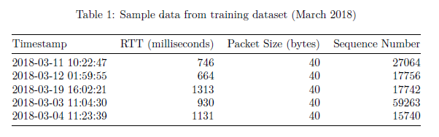
Dataset details
Data was collected in month of March and April 2018 from a communication network.
Table 1 shows 5 random rows from the clean dataset.
We are only interested in RTT.
Most of the mass is concentrated in the 500ms to 1500ms range
During peak network congestion, sometimes RTT could go upto 15 to 20s which explains the long tailed distribution

Slide 5
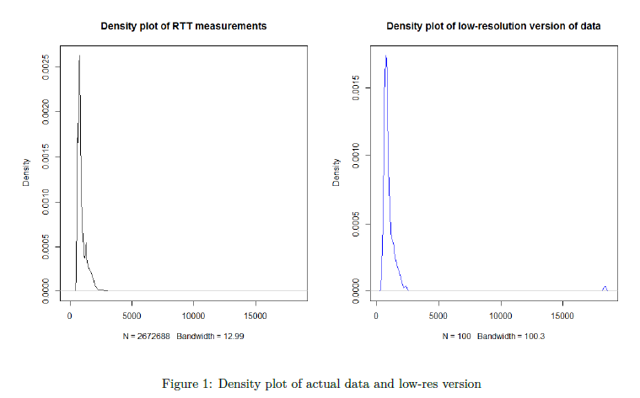
Methods
Figure 1 shows probability density for the entire dataset and a low-res version.
Low-res version created by taking percentiles 1..100 of the original data
Provides for better modeling of new data
Density plots for actual and low-res version are very similar (although note scale on Y-axis is not the same)

Slide 6


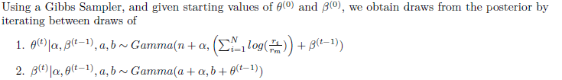
Methods (contd.)
Pareto Type I distribution is used to model the (low-resolution version) of RTT measurement data. The Pareto Likelihood can be written as
The scale parameter is fixed at the minimum RTT value seen in the dataset and the shape parameter (theta) is modeled in two ways
Model 1: Flat prior
Model 2: Gamma conjugate with a hyper parameter using Gibbs sampler

Slide 7
Methods (contd.)
Adequacy of fit
Take 20,000 draws of theta from the posterior and create replicates using each of the draw
Compute credible interval for test statistics T_10, T_20,..,T_100 (deciles of samples in the replicate)
Determine if test statistic from observed data exists in the credible interval
Compare results for model 1 (flat prior) and model 2 (Gibbs sampler)
Check convergence of theta and beta using visual summaries, Gelman Rubin diagnostic.
Inference on new data
Prediction on new data without collecting lot of new data: Use scale (min of dataset) for new data (say collected for a day in April) and create posterior summaries for test statistic using theta from training dataset)
Has network performance changed: Recompute model with new data and compare credible interval for key test statistic

Slide 8
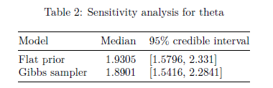
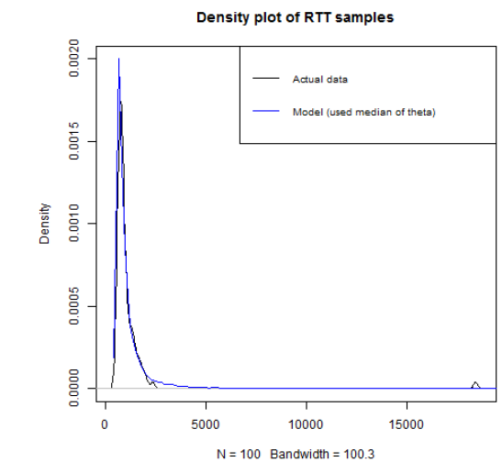
results
Sensitivity Analysis (flat prior Vs Gibbs sampler)
Comparison of theta under both models

Slide 9
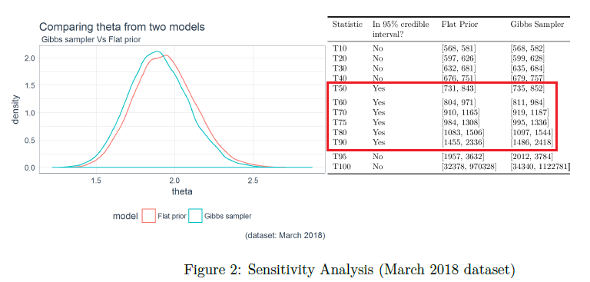
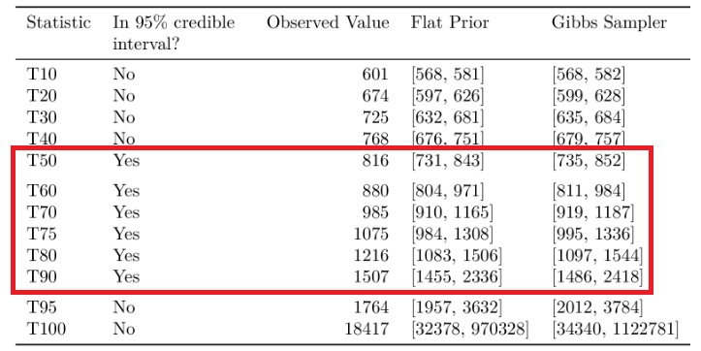
Results (contd.)
Sensitivity Analysis (flat prior Vs Gibbs sampler)
Both models almost equivalent in terms of test statistics falling within 95% credible interval

Slide 10
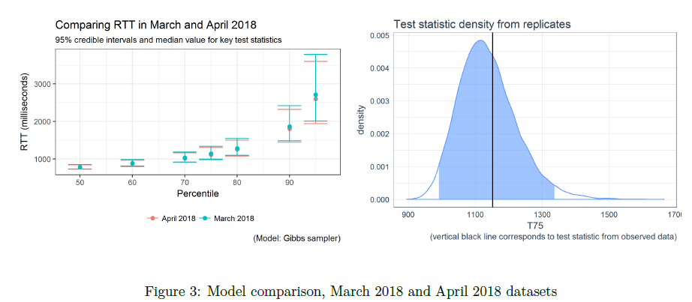
Results (contd.)
Inferences on new data (April 2018)
Credible interval seem to have shifted towards smaller RTT (network is less congested)
T_75 (75th percentile of RTT values still within 95% credible interval using theta from training dataset)

Slide 11
Discussion of results
All code, paper and this presentation are available at https://github.com/aarora79/rttmodelR
The sensitivity analysis indicates that there is little to choose from between the flat prior model and the Gibbs sampler with conjugate prior.
The models fits only about half the density. Portion of the density that the models do fit are the more important portions.
The credible interval for the month of April seems to have shifted towards slightly smaller RTT values.
Hints towards was some change in the network which resulted in network traffic experiencing smaller latencies. A network operator familiar with this particular network should be able to attribute this reduction in latency values.
Future work
The RTT distribution is long-tailed but not heavy tailed i.e. the very small percentage of packets experiencing very large delays is probably not very important. Consider alternate models (like Gaussian Mixture Models) to model portions of the distribution containing 95% of the mass. Another alternative is to consider a bounded Pareto distribution where both lower and upper bounds are defined.

